Slide 1
Semántica Web
Group 06
Javier Balanzategui Sánchez
Mario Estruel García
Laura Arranz Martinez
Pablo Cantón García
David Castrillo Arrabal

Slide 2



Step
1
2
3
4
5
Dataset requirements
R1- Data are in the smart cities domain.
R2- Data are available as a CSV file.
R3- Data have an open license so it can be published.
R4- Data can be easily linked with generic real-world entities.
R5- Documentation exists for the data.
R6- Data can come from multiple data sources.
Make Mockup

Slide 3



Step
1
2
3
4
5
The application notify the user of pollution levels in Madrid, helping by offering alternative and assistance.
Contamination levels
Public bike parking
Free public parkings

Slide 4
Step
1
2
3
4
5
Avaible Real-Time data in:
Contamination levels
http://datos.madrid.es/egob/catalogo/212531-10515086-calidad-aire-tiempo-real.txt
Public bike parking
http://datos.madrid.es/egob/catalogo/208327-1-transporte-bicicletas-bicimad.csv
Public parkings
http://datos.madrid.es/egob/catalogo/202625-0-aparcamientos-publicos.csv

Slide 5


Step
1
2
3
4
5
Datasets perform:
Analyse Data Set.
Analyse Licensing of the Data Source.
Define Resource Naming Strategy.
Develop Ontology.

Slide 6
Step
1
2
3
4
5
Using LODRefine, Clean-up useless (in our application context) columns, merge information from different columns or sources, split information…etc

Slide 7

Step
1
2
3
4
5
Perform datasets:
Import data. Import data into LODRefine.
Analyse and fix data. Fix the data to facilitate the process of generating RDF from them.
Export to RDF. Define an RDF skeleton for the data and export it to RDF, using the Turtle syntax.

Slide 8
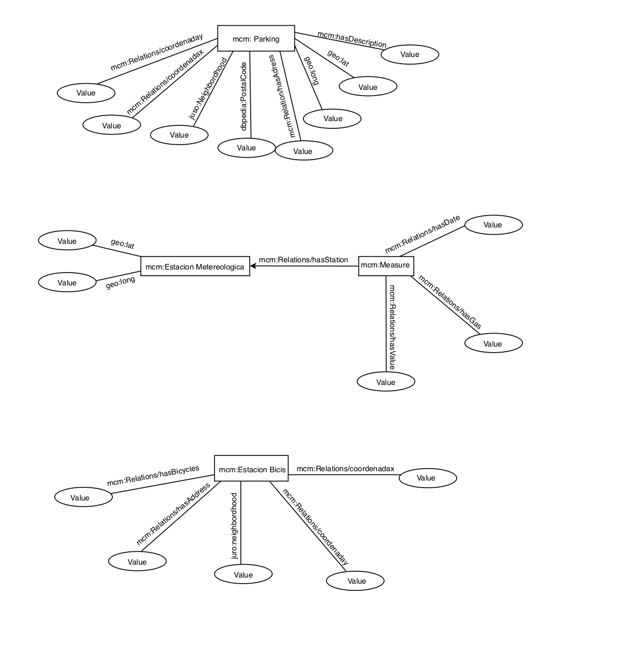
Step
1
2
3
4
5

Slide 9
Step
1
2
3
4
5
The ontologies perform
Ontology search: Search for existing ontologies and properties.
Ontology selection: Select the classes and properties that best fit
Ontology implementation: Update your ontology.
Data generation: RDF data using the updated version of the ontology.

Slide 10
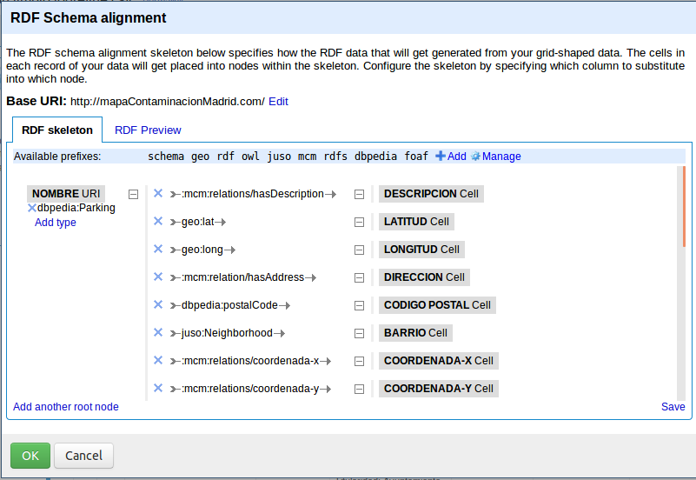
Step
1
2
3
4
5

Slide 11
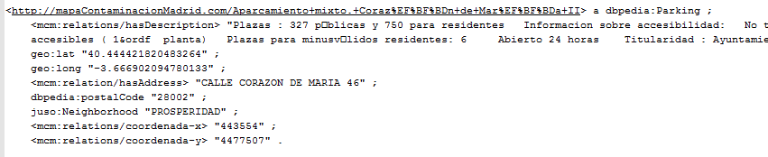
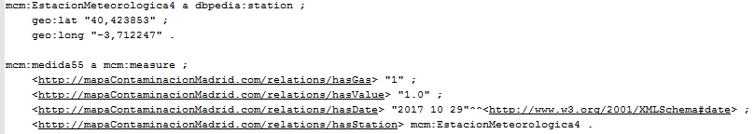
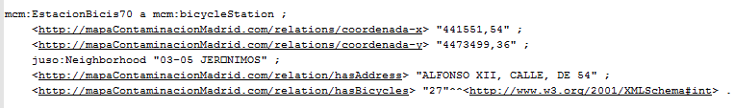
Step
1
2
3
4
5

Slide 12
Step
1
2
3
4
5
Develop the App
Webpage were users can display all the information.
Virtuoso Server where triples are stored and managed.
Connect Webpage to Virtuoso Server throught PHP connectors.

Slide 13
Demo
Demonstration of the application. .

Slide 14



Conclusions
Teamwork
New code languages
Use of new technologies

